Slide 1
Central PA Chapter
BetterInvesting
October 9, 2018
Part 1: Cheat Sheet for the Stock Selection Guide (SSG)
John and Donna Diercks
jwdiercks@aol.com
dmhdiercks@aol.com
Disclaimer – any companies used in this presentation are for educational purposes only and are not intended as investment recommendations

Slide 2
Copyright and Use Permission
This presentation is the copyrighted property of John and Donna Diercks. It may not be used, in whole or in part, without our prior written consent or that of the Central Pennsylvania Chapter
Your use of this presentation also requires that you use the following copyright notice:
  “Copyright 2017 John and Donna Diercks. All rights reserved. This material is presented with permission of the authors.”
Notes:
We put the copyright on our original work since we might be presenting this in other venues. However, you are most welcome to use this resource, and it will be available to you on our secured website at myiclub.com.

Slide 3
What Will be Covered
Purposes of the SSG
Development of the SSG Cheat Sheet
Review of the SSG Plus print version
Guidelines for the SSG
Benchmarks used for making judgment decisions

Slide 4
Two Purposes of the SSG
Determine a company’s quality using information from Sections 1 and 2
At the current stock market price is the stock price in the buy, hold, or sell zone

Slide 5
Development of the Cheat Sheet
Developed around 2002
Needed to have guidelines and benchmarks within easy access
Developed to be an easy to use resource tool
Upgraded recently into a PowerPoint

Slide 6
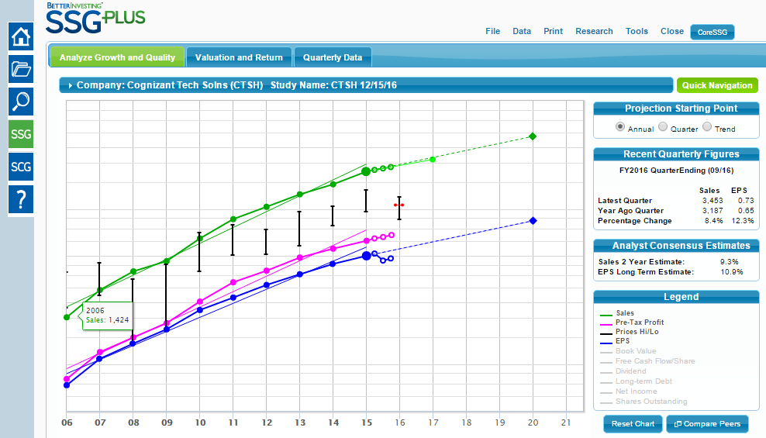
Where to Get Printed Version of SSG Plus for CTSH Used in this Course
Click Here
Get form for printing here

Slide 7
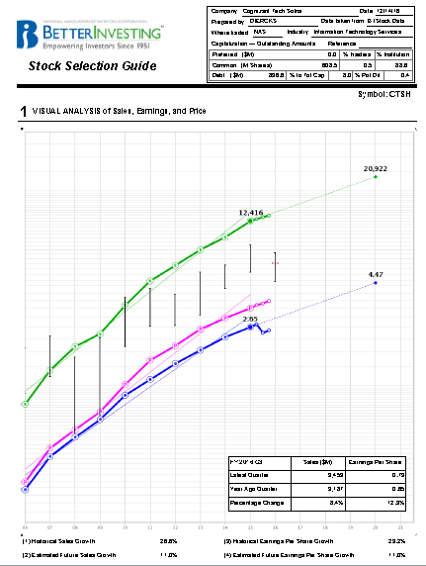
SSG Plus Page 1
Data for Cognizant Tech Solutions,
FY 2016, Q3

Slide 8
Company Data
SSG Information on Page 1
Estimated Future 5-Year Sales and Earnings Growth
Visual Analysis
10-Year Historical Sales and Earnings Growth
Quarterly Data

Slide 9
Brief overview of the Value Line Stock Report
Click for Value Line Stock Report

Slide 10
Importance
Value Line’s Stock Report includes a wealth of information to help with judgments and to fill in missing data on the SSG
Valuable reference to assist with stock studies

Slide 11
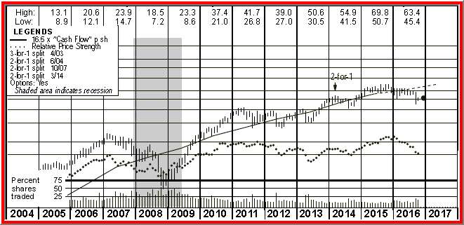
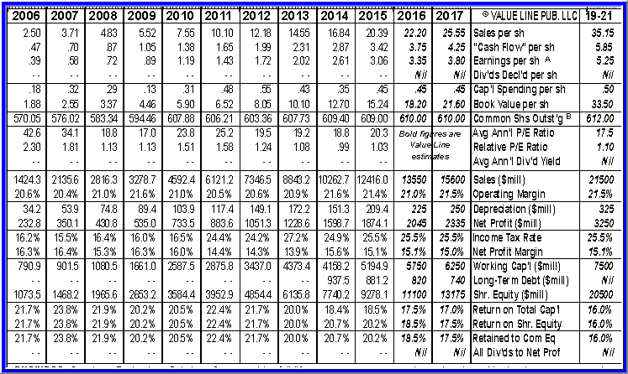
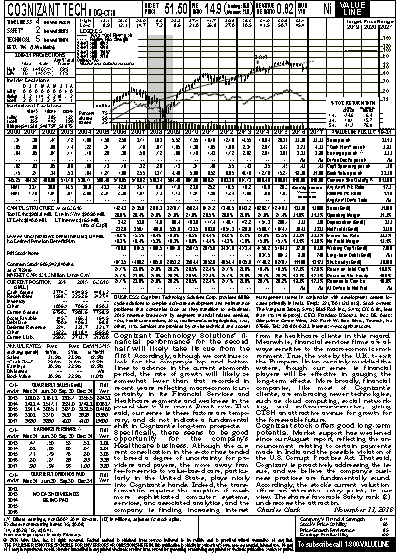
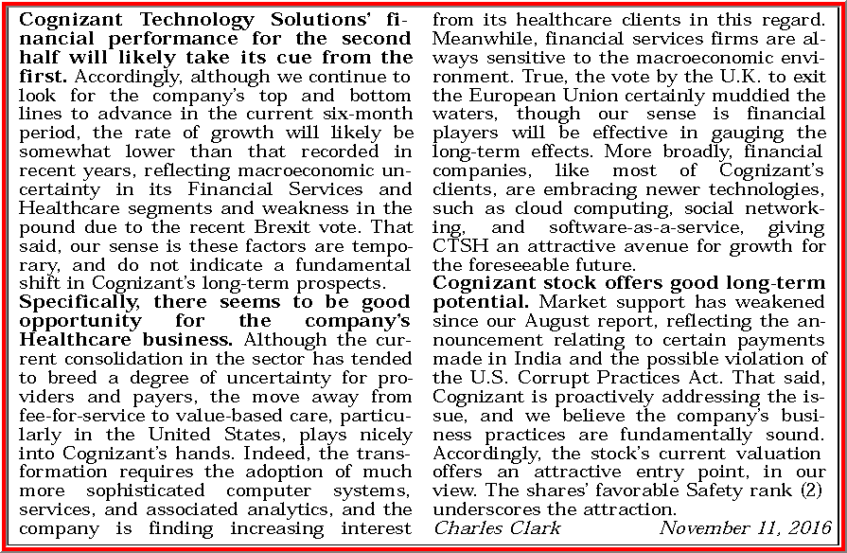
Sections of Value Line’s Stock Report
Chart
Statistical Array
Analyst’s Comments
Footnotes

Slide 12
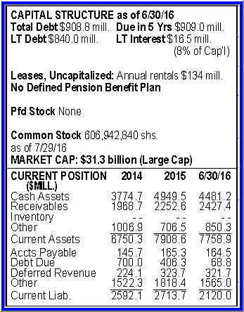
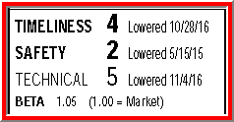
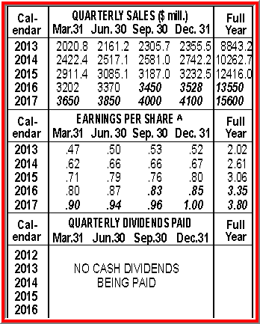
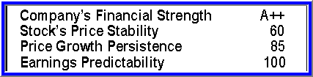
Sections of Value Line’s Stock Report, cont’d
Ranks
Chart
Statistical Array
Balance Sheet Data
Analyst’s Comments
Quarterly Data
Ratings
Footnotes

Slide 13
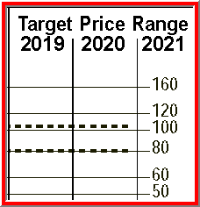
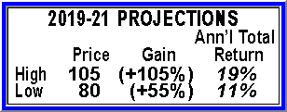
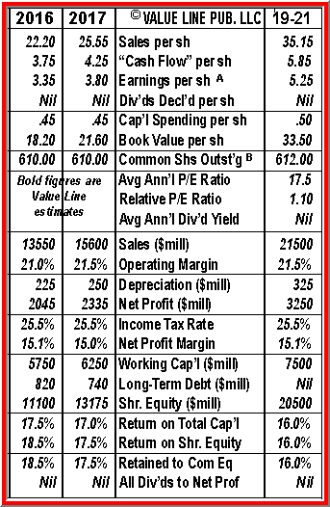
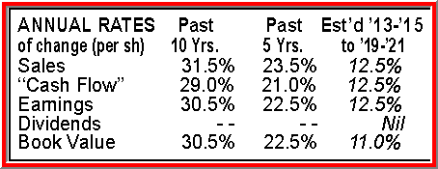
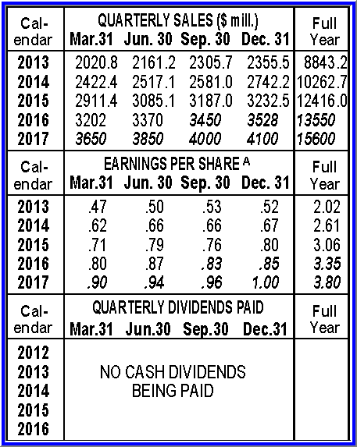
Sections of Value Line’s Stock Report, cont’d
Ranks
Chart
Statistical Array
Forecasts
Balance Sheet Data
Analyst’s Comments
Quarterly Data
Ratings
Footnotes

Slide 14
Now to individual sections of the SSG

Slide 15
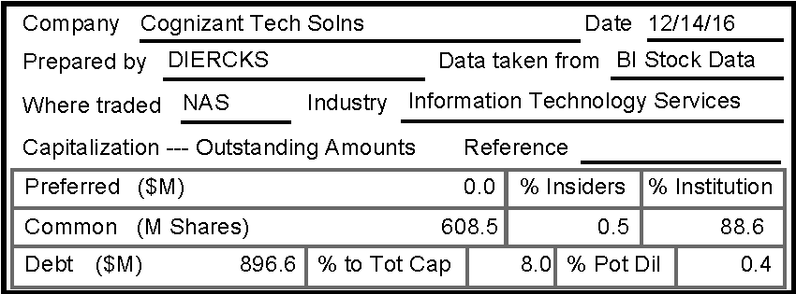
Basic Information

Slide 16
Common Shares Outstanding

Slide 17
Debt
Debt = Short Term Debt + Long Term Debt, AKA Total Debt
Short term debt is debt owed in less than one year
Long term debt is debt owed beyond one year

Slide 18
Debt to Total Capital
Total Capital = Shareholder’s Equity + Long Term Debt
Desirable: Total debt ≤ 33%
Long term debt ≤ 25%
Varies by industry
Notes:
Reuters.com is a good financial website to check industry averages for your company under study.

Slide 19
Common Shares Owned by Insiders
Percent of stock owned by company insiders
Small revenue size company ~25%
Large revenue size company ~1%
Notes:
Insiders = the officers and directors of a company.

Slide 20
Common Shares Owned by Institutions
Percent of stock owned by large institutions, such as banks and mutual funds
40 – 50% is desirable
Today 80 – 90% common
Notes:
Institutions are Banks, Mutual Funds, Exchange Traded Funds, Hedge Funds. Institutions are buying more stocks today due to 401K plans and IRA’s (individual retirement accounts as people have to plan for their own retirement plans today – few pensions plans are available. Also people have 529 plans for their children’s education funds.

Slide 21

Side Note: Company’s Quality
Company “Quality” is on the Toolkit 6 printout but is omitted on the SSG Plus printout
It’s important to consider “Quality.” This is normally a “Company’s Financial Strength” from the Value Line (VL) report
Want B+ or higher from Value Line for Company’s Financial Strength (lower right hand corner of VL stock report)

Slide 22
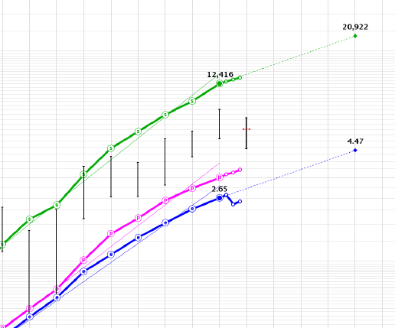
Visual Analysis
Sales
Yearly Price Range
Current Price
Pre-Tax Profit
Look for lines that are up, straight, and parallel
Earnings per Share

Slide 23
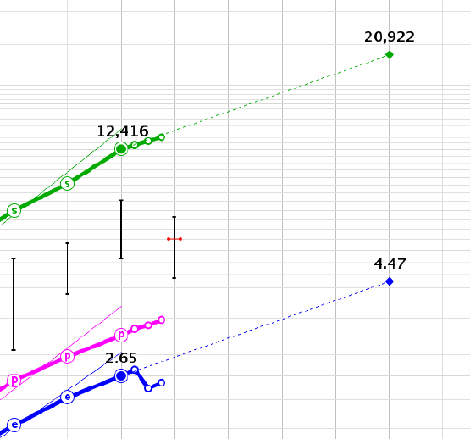
Your projection out 5 years
VL $21,500
Do not exceed Value Line (VL) 3 – 5 year projections
Last Yearly Sales and EPS
Current Price
VL $5.25
Your projection out 5 years

Slide 24
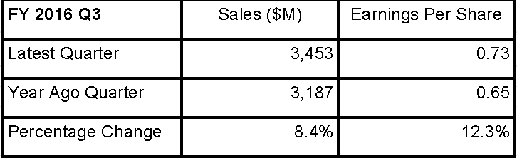
Latest Quarterly Sales and Earnings per Share
Small Rev Comp: Sales ≤ $1B/Year; Expected Growth: 12%+
Medium Rev Comp: Sales $1B - ≤ $10B/Year; Expected Growth: 7-12%
Large Rev Comp: Sales > $10B/Year; Expected Growth: 5-7%
Ultra-Slow Mega Rev Comp: Sales > $50B/Year : Expected Growth <5%

Slide 25
How to Calculate Percentage Change
Subtract year-ago quarter sales from latest quarter sales
Divide above result by year-ago sales
Multiply by 100 for percentage

Slide 26
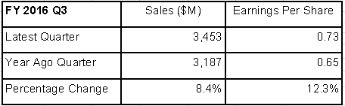
Latest Quarterly Sales and Earnings per Share
10-year Historical Sales and Earnings Growth

Slide 27
Note: Check your projections for sales and EPS to confirm they are not higher than Value Line’s (VL) 3 – 5 year projections. VL’s sales projection was 12.5%, and the EPS projection was 12.5%
Estimated 5-year Future Sales and Earnings Growth
Check Quarterly Growth Chart before setting sales and EPS projections
Rule of Thumb: forecast sales and earnings growth ≤ 15%
Notes:
Do not predict future earnings per share growth to be higher than 15%. It is okay to go up to 20% if this is a fast growing company (more in its infancy than being a mature company).

Slide 28
Diversifying by Company Size and Expected Growth Rate
Size | Revenue | Expected Growth
Small | ≤ $1B/year | More than 12%+
Medium | >$1B - ≤ $10B/year | 7 – 12%
Large | >$10B - ≤ $50B/year | 5 – 7%
Mega | > $50B/year | Less than 5%

Slide 29

Questions?

Slide 30
Central PA Chapter
BetterInvesting
January 10, 2017
Part 2: Cheat Sheet for the Stock Selection Guide (SSG) Plus
John and Donna Diercks
jwdiercks@aol.com
dmhdiercks@aol.com
Disclaimer – any companies used in this presentation are for educational purposes only and are not intended as investment recommendations

Slide 31
What Will be Covered
SSG Plus – page 2
Guidelines for the SSG
Benchmarks used for making judgment decisions

Slide 32
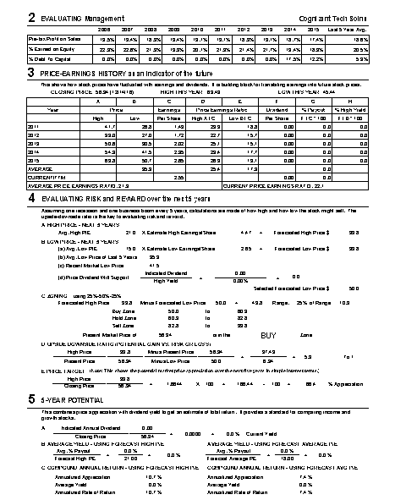
Stock Selection Guide Plus
Page 2
Data for Cognizant Tech Solutions,
FY 2016, Q3
Notes:
To do: Add Coach FY 2013, Q1

Slide 33
SSG Plus Page 2
Quality Analysis
High/Low Price, Price/Earnings Ratio, and Dividend Analysis
Evaluating Reward and Risk over the Next 5 Years
Total Return Analysis

Slide 34
Definitions for Section 2 of the SSG
Pre-tax Profit on Sales = (Pre-tax Profit ÷ Sales) x 100
Shareholder’s Equity = Assets – Liabilities
Return on Equity (ROE) = (Net Income ÷ Shareholder’s Equity) x 100
%Debt to Capital = (Total Debt ÷ Capital) x 100

Slide 35
Management’s Three Jobs
Make Money to invest in new assets (Pre-Tax Profit on Sales)
Spend Money to increase shareholders’ equity (Return on Equity)
Control Debt to grow sales and earnings from organic resources (Percent Debt to Capital)

Slide 36
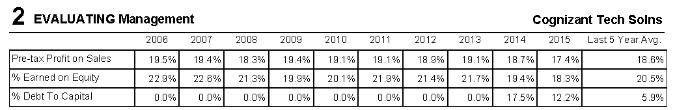
Quality Analysis
General Benchmarks:
    Pre-tax Profit on Sales, 15% or greater
    ROE, 15% or closer to 20% is preferred; don’t like many single digits over time
    Debt to Capital, 33% or less
Go to Financials at www.reuters.com to view industry averages as these benchmarks vary from industry to industry

Slide 37
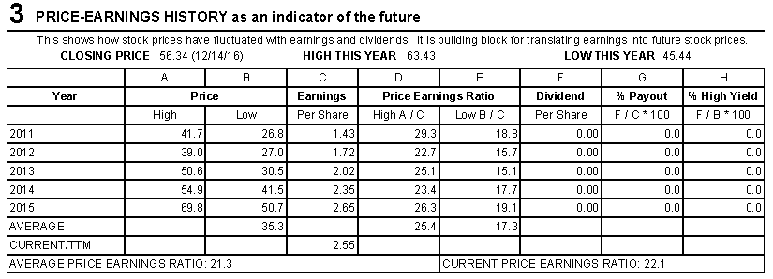
Section 3: High/Low Price, Earnings, Price/Earnings Ratio, and Dividend Analysis
Average Price/Earnings Ratio, a.k.a. Historical P/E
Average P/E = (Average High P/E + Average Low P/E) ÷ 2

Slide 38
Relative Value
Relative Value = (Current P/E ÷ Historical Average P/E) x 100 = 104%
  Buy = 80 ̶ 110%
  Hold = 110 ̶ 150%
  Sell > 150%
Click for Value Line/PE

Slide 39
PEG Ratio
PEG Ratio = Current P/E ÷ Forecast EPS Growth Rate
= 22.1/11.0 = 2.0
    Buy = 1.0 – 1.5
    Hold =1.5 – 2.0
    Sell > 2.0
Forecast EPS Growth Rate from Side 1

Slide 40
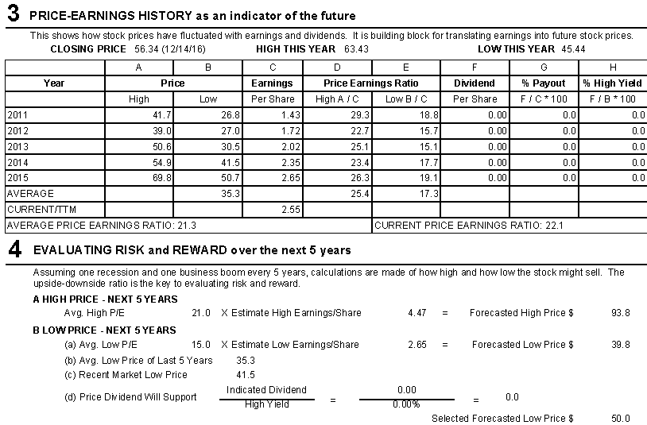
4 Evaluating Reward and Risk Over the Next 5 Years
Setting high price
Do not set high P/E > 30
VL projected average annual P/E of 17.5
EPS projected on page 1
VL 3-5 year range = $80 - $105
Click for Value Line

Slide 41
4 Evaluating Reward and Risk Over the Next 5 Years
Setting low price
Check 52 week low
$2.65 was projected from page 1

Slide 42
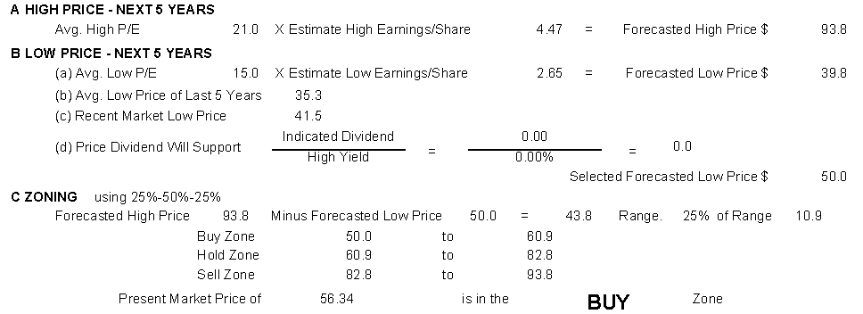
Zoning
CTSH is in the buy zone. Current price is $56.34, which is between $50.00 and $60.90.

Slide 43
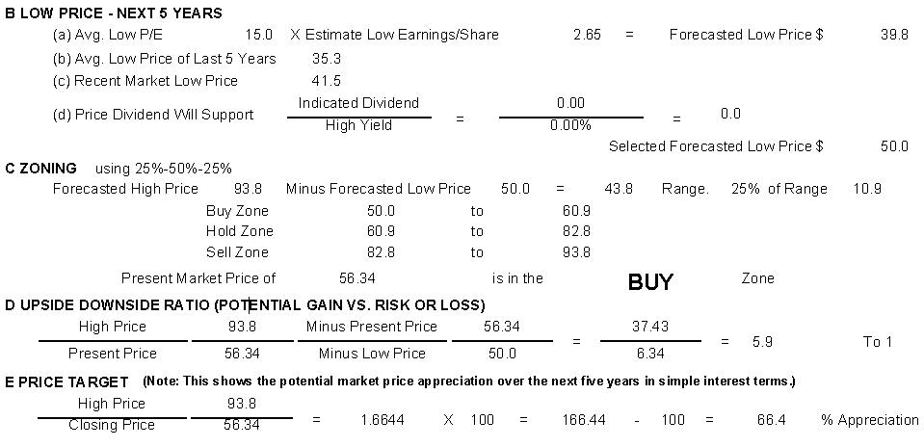
4D Upside Downside Ratio (Potential Gain vs. Risk or loss)
If over 10 to 1, the upside/downside ratio is invalid. Usually the estimated low price is set too high

Slide 44
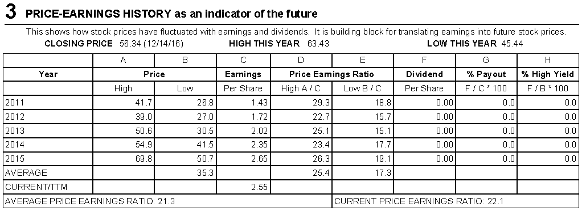
3 Dividend Analysis
Average Percent Payout Ratio

Slide 45
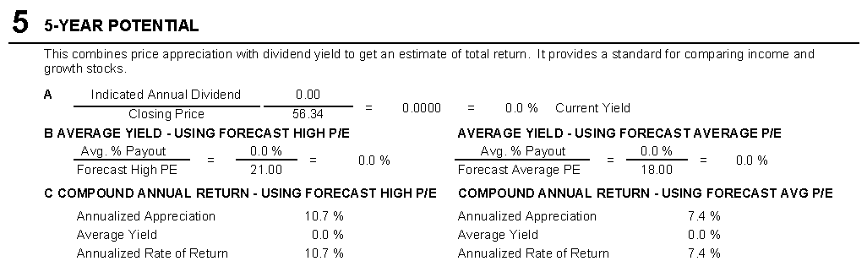
5 Total Return Analysis
Current Yield and Average Percent Payout Ratio from Section 3
Selected High P/E from Section 4

Slide 46
Compound Annual Returns
Average of High P/E (21) and Low P/E (15) from Section 4
Value Line projects 11 – 19% compounded annual return. Need 15% return to double money in 5 years
Click for Value Line

Slide 47
Conclusion
The Stock Selection Guide is a helpful tool for long-term investors
Understanding guidelines and benchmarks help investors analyze information found on the SSG
Benchmarks also help investors make more realistic judgment decisions when projecting future performance

Slide 48
Questions?

Slide 49
Central PA Chapter
BetterInvesting
January 10, 2017
Cheat Sheet for the Stock Selection Guide (SSG)
Donna and John Diercks
jwdiercks@aol.com
dmhdiercks@aol.com
We thank you!

